Slide 1

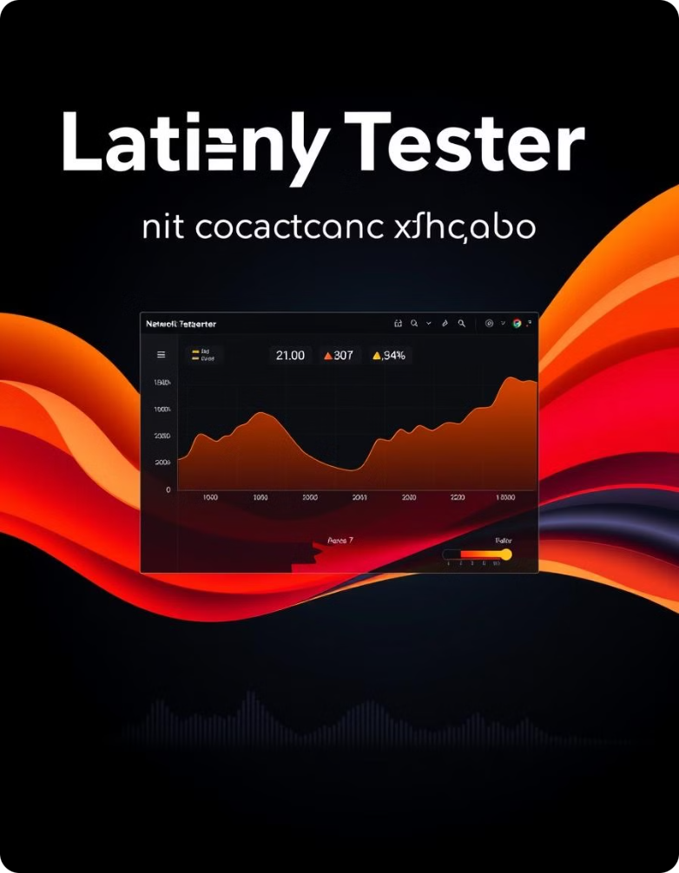
Network Latency Tester
Welcome to the network latency tester presentation. This innovative tool empowers users to analyze and optimize their network performance.

Slide 2

Problem Definitions
1
Unreliable Connections
2
Performance Bottlenecks
Network latency can cause frustrating lags, interruptions, and slow loading times, negatively impacting user experiences.
Latency can be a significant bottleneck for various online activities, such as gaming, video conferencing, and streaming.
3
Network Troubleshooting
4
Data Insights
Network latency data provides valuable insights into network health, enabling users to make informed decisions about their network infrastructure.
Identifying and diagnosing latency issues is crucial for optimizing network performance and resolving connectivity problems.

Slide 3
System Design
Packet Transmission
Latency Calculation
Data Visualization
The tester sends test packets to a target server and measures the time it takes for the packets to return.
The time difference between sending and receiving packets is calculated, providing an accurate measurement of network latency.
Latency data is presented visually in real-time, allowing users to easily identify trends and potential issues.

Slide 4
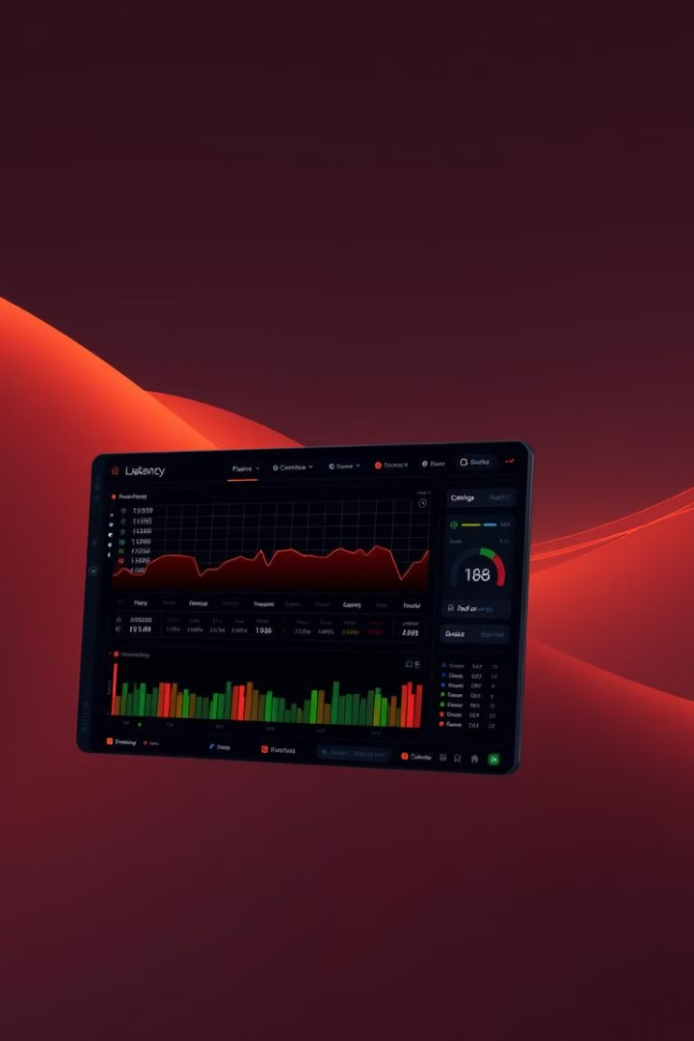
Core Features
Ping Test
Traceroute
Measures the round-trip time for packets sent to a specific IP address or hostname.
Provides a detailed path taken by packets from the user's device to the target server.
Bandwidth Measurement
Customizable Settings
Allows users to adjust test parameters, such as packet size and number of packets, for optimal results.
Evaluates the available bandwidth for the user's connection, identifying potential bandwidth constraints.

Slide 5
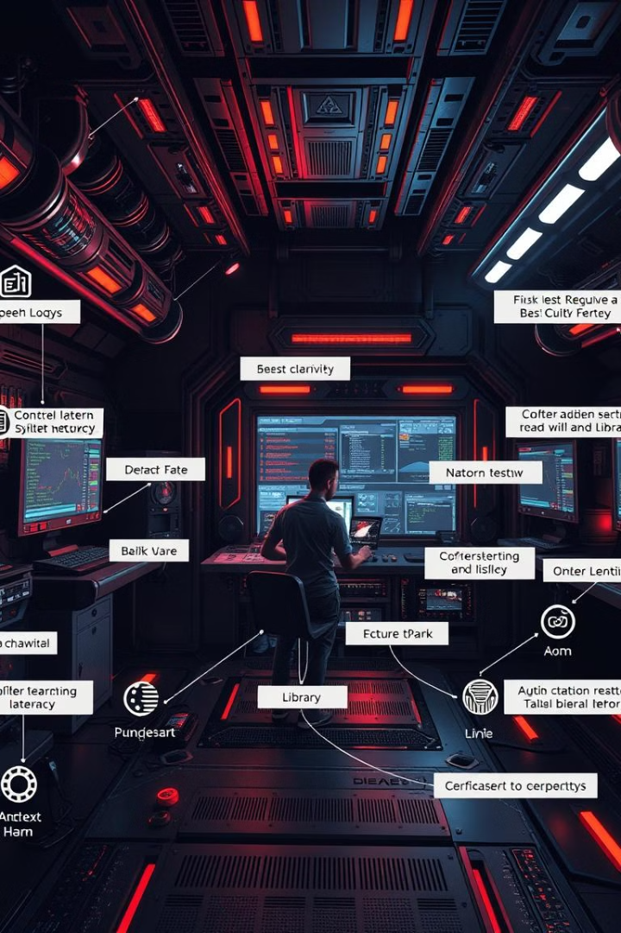
Technology Stack
Programming Language
Python
Networking Library
Socket
Data Visualization Library
Matplotlib
GUI Framework (Optional)
Tkinter

Slide 6
Implementation Process
Requirements Gathering
1
Define the functionalities, user interface, and technical specifications for the latency tester.
2
Design and Architecture
Develop the system architecture, choose programming languages and libraries, and create a detailed design plan.
Code Implementation
3
Write the code for each component, including packet transmission, latency calculation, data visualization, and user interface.
4
Testing and Debugging
Thoroughly test the functionality, performance, and reliability of the latency tester, addressing any issues or bugs.
Deployment and Release
5
Prepare the application for deployment, package it appropriately, and release it to users.

Slide 7
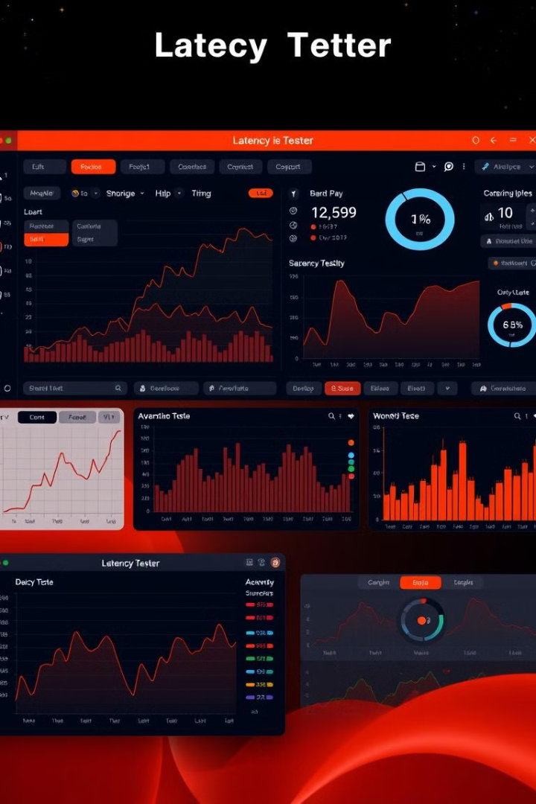




User Interface
Target Selection
Latency Graph
Allows users to specify the IP address or hostname of the target server for testing.
Displays real-time latency data visually, enabling users to monitor and analyze network performance.
Configuration Options
Detailed Information
Provides options to adjust test parameters, such as packet size, number of packets, and test frequency.
Displays detailed information about the test, including the target server, packet loss, and latency statistics.

Slide 8





Testing
Unit Testing
Test individual components and functions to ensure they work as expected.
Integration Testing
Test the interaction between different components to verify their compatibility and proper data flow.
System Testing
Test the entire application to ensure it meets all requirements and functions as intended.
Performance Testing
Assess the latency tester's performance under different network conditions and user loads.
User Acceptance Testing
Have potential users test the application to gather feedback on its usability, effectiveness, and overall satisfaction.

Slide 9

Challenges and Solutions
Accurate Latency Measurement
Data Visualization
Create clear and informative visualizations that effectively communicate network latency data to users.
Ensure precise latency measurement by minimizing the impact of factors like network jitter and packet loss.
User Interface Design
Design a user-friendly interface that is intuitive, easy to navigate, and provides a seamless experience.

Slide 10
System Design
This section delves into the architectural design of the network latency tester, outlining its key components, relationships, and functionalities. The design considerations focus on achieving optimal performance, scalability, and user experience.
The latency tester is built upon a modular architecture, enabling flexibility and ease of maintenance. Key components include a data acquisition module responsible for capturing network packets, a processing engine for analyzing latency data, and a visualization module responsible for presenting the results in a user-friendly manner.
The architecture prioritizes efficiency by leveraging lightweight data structures and optimized algorithms. The system is designed to handle a large number of concurrent tests, ensuring responsiveness even under heavy network traffic.

Slide 11
Conclusion
The network latency tester provides a robust and efficient solution for measuring and analyzing network performance. Its user-friendly interface and comprehensive features empower users to gain valuable insights into their network connectivity, enabling them to optimize their network configuration and troubleshoot any potential issues. The system's modular architecture facilitates scalability and future development, ensuring that it can adapt to evolving network demands.

Slide 12

We appreciate your time and interest in our network latency tester. We believe this tool will be valuable for anyone seeking to understand and optimize their network performance.

